Slide 1
SMART ATTENDANCE SYSTEM BY USING FACE RECOGNITION ALGORITHM
PRESENTED BY
GOKUL NATH S
GRT IET ,THIRUVALLUR

Slide 2
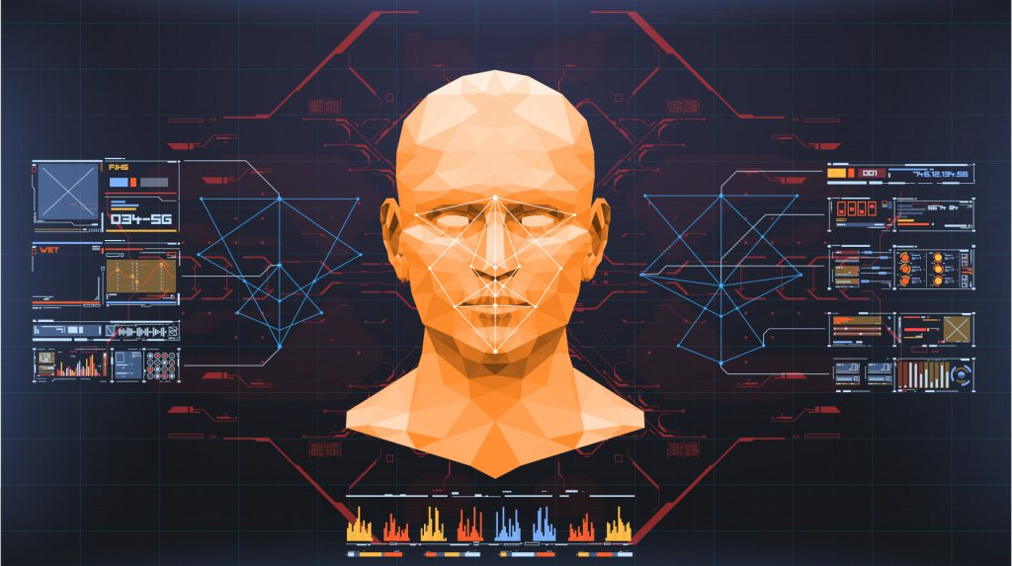

Slide 3
INTRODUCTION
Smart attendance systems use facial recognition to automate attendance-taking. These systems can detect and recognize multiple people's faces from a video stream. They can automatically record daily attendance and have an average recognition accuracy of about 92%.

Slide 4
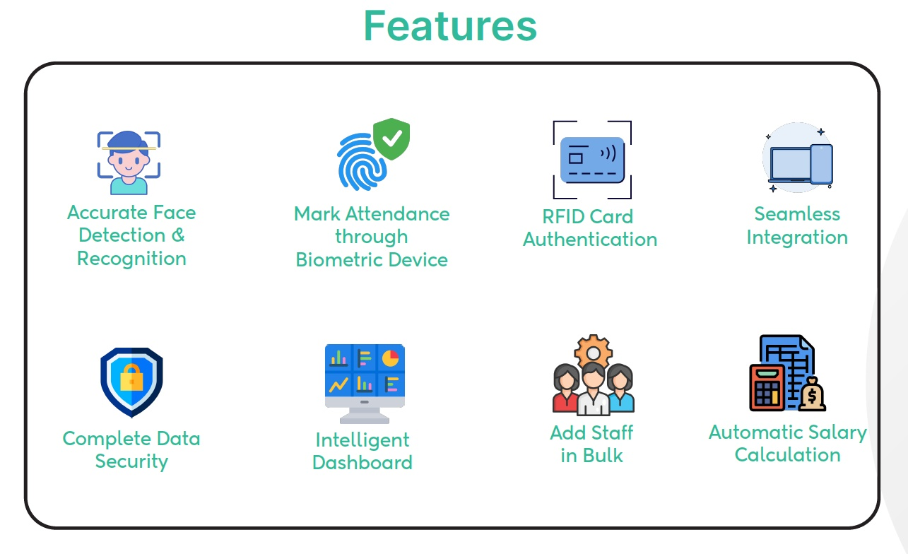

Slide 5
ADVANTAGES
Smart attendance systems can:
Eliminate time theft
Increase the productivity of the HR department
Save up to $1600 per employee each year
Enhance workplace security
Improve employee wellness and productivity
Automate time tracking
Integrate easily with other systems
Manage records easily

Slide 6
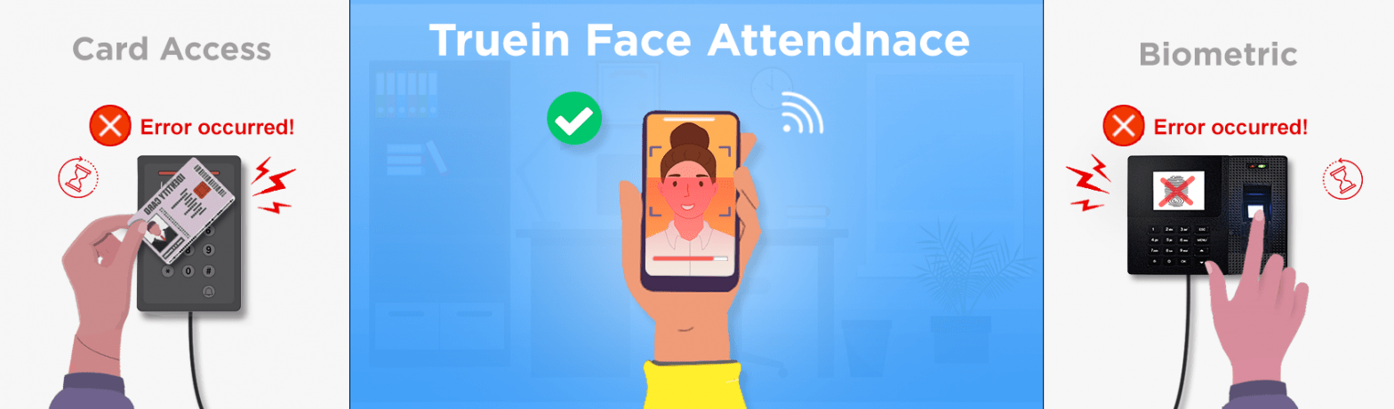
REQUIRMENTS
IDLE PYTHON
OPEN CV MODULE PACKAGE
FACE RECOGNITION MODULE PACKAGE
MICROSOFT EXCEL
SYSTEM WITH CAMERA

Slide 7

IDLE PYTHON
What does IDLE do for Python?
IDLE is Python's Integrated Development and Learning Environment. It allows programmers to easily write Python code. Just like Python Shell, IDLE can be used to execute a single statement and create, modify, and execute Python scripts.

Slide 8
OPEN CV AND FACE RECOGNITION PACKAGES
OpenCV is a free, open-source, and cross-platform library that includes hundreds of computer vision algorithms. These algorithms can be used in Python, C++, Java, and MATLAB.
Face detection is a process of identifying human faces in images or videos. It is a rapidly expanding area of computer vision that offers a variety of useful applications, such as security systems, face identification, and picture analysis.

Slide 9
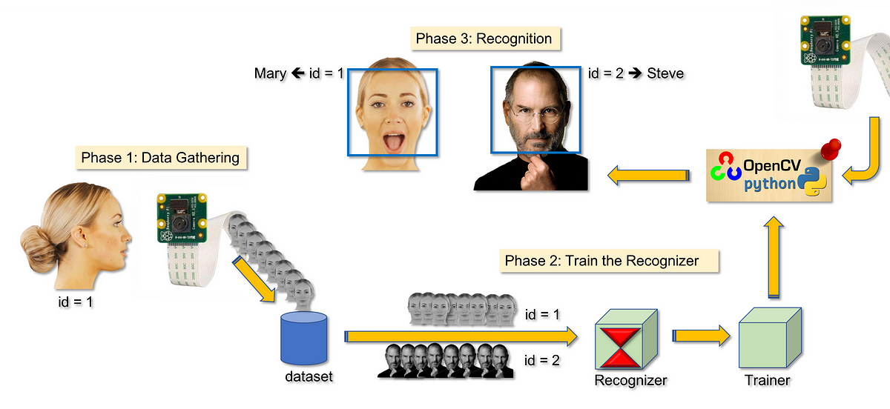

Slide 10
ALGORITHM
The deep learning algorithm that is were using for the smart Attendance Management System is the face recognition model. This model uses a deep convolutional neural network (CNN) to extract features from facial images and learn to map these features to a unique embedding vector for each individual.
The model is trained on a large dataset of facial images using a supervised learning approach, where it learns to minimize the difference between the predicted embedding vector and the true identity of the individual. The pre-trained face recognition model used in the above code is based on the ResNet architecture and has been trained on a large-scale face recognition dataset called VGGFace2.

Slide 11
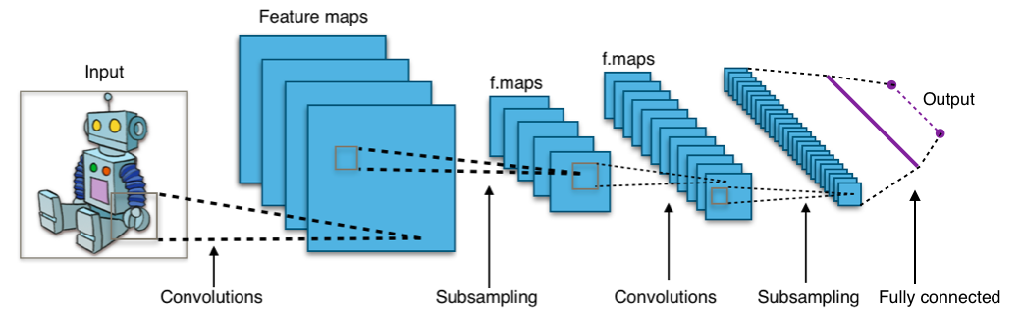
Deep Convolutional Neural Network (CNN) Architecture

Slide 12
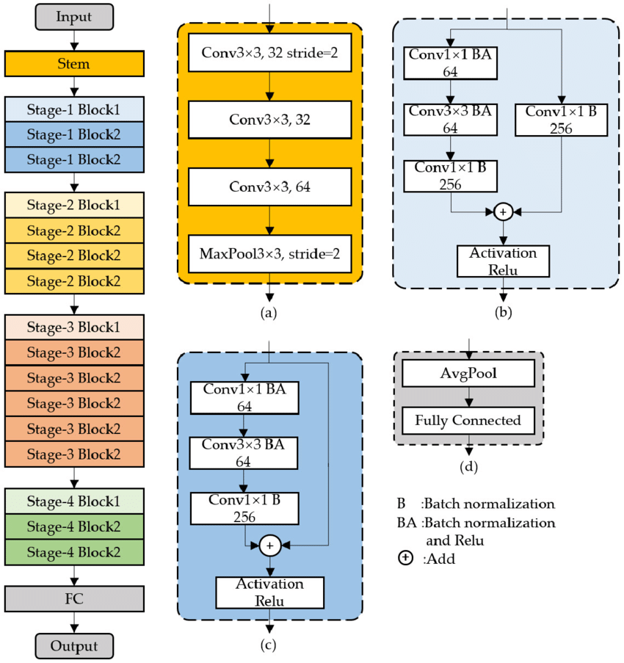
ResNet Architecture

Slide 13
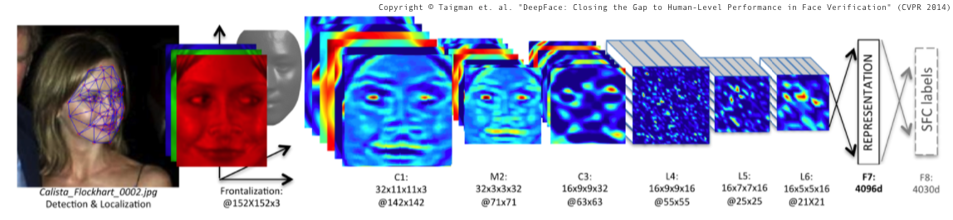
VGGFace2 Dataset

Slide 14
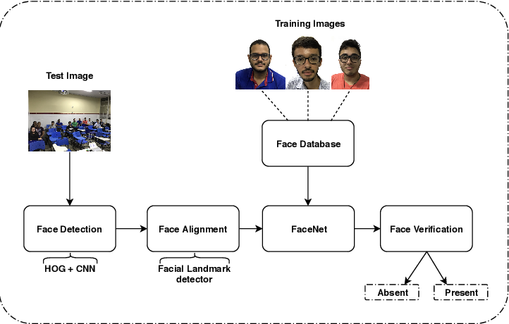
FLOWCHART

Slide 15
PROCEDURE AND WORKING
As per the algorithm we need to create the python code for face recognition.
After that we can able to run the code and so that the camera gets on and store our image as per our name.
And these photos are stored in the database.
Then we can use the face recognition algorithm .
From that we can able to detect the images from the class which is being stored in the database and the attendance is being marked on the excel sheet

Slide 16


Slide 17
OUTPUT
From the given data we can able to observe the data which is being marked on the excel sheet
This is how the smart face recognition system works

Slide 18
CONCLUTION
This is one of the upcoming technologies from which we can make or work easier and simple.
Organizations can make use of these techniques and can able to get the attendance of the employees or students.

Slide 19


Slide 20
THANK YOU
ANY QUESTIONS…?

